Slide 1
ECE 540: Now in 3D!
Ian Wyse
Hunter Drake
Nelson Rodriguez-Ortiz
Paul Globisch

Slide 2
Agenda
Project Overview
Peripherals Register Map
Keyboard
VGA
Hardware detailed description
Keyboard
VGA
Software detailed description
Raycasting
Mesh Rendering
Drivers
Conclusion
Project Demo
Future Work

Slide 3
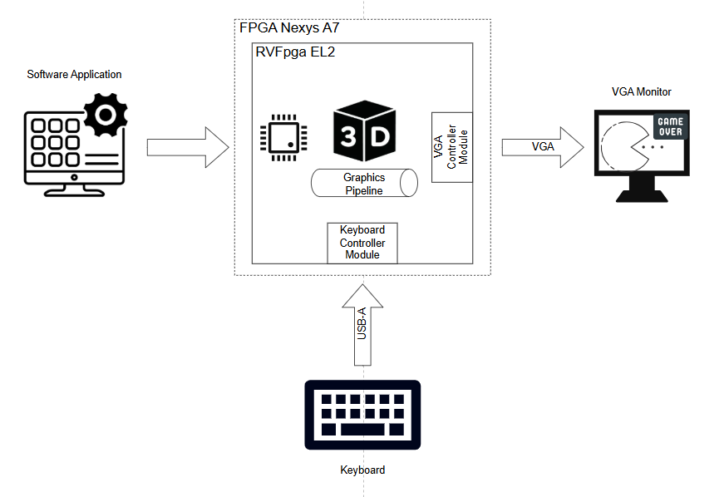
Project Overview
Extending FPGA SoC applications to draw 3D objects with distinctive attributes into a 2.5D “exploration video game”-liked scene.
Similar to the 1990s Doom and Wolfenstein games
Components
FPGA Nexys A7 board
Keyboard
VGA Monitor
RVFpga EL2 ecosystem
Hardware
2.5D and 3D rendering graphics pipelines
Software
Raycasting
Cube decomposition

Slide 4
RVFpga Peripherals Register Map
Frame Buffer Index Register (Read Only)
Debug register that shows what BRAM buffer is currently being displayed on the VGA screen.
Column Drawing Register (Read and Write)
Used to draw vertically-centered rectangles (walls) on the screen for a 2.5D environment.
Frame Calculation Done Register (Write Only)
Used to tell the GPU that the frame is done being drawn and to switch BRAM buffers.
Status Register (Read Only)
Used to determine the status of the GPU (FIFO full, empty, overflow, GPU busy)
Control Register (Read and Write)
Used to control how the GPU does what it is doing.
Command Register (Write Only)
Used to write triangle data to the GPU for processing.
Keyboard Register (Read Only)
Used to determine if movement keys (WASD) are pressed.

Slide 5
Hardware Detailed Description: Keyboard
Keyboard interface uses PS/2 - 8 bit scancode for each character.
Start bit (0), 8 data bits, parity bit, stop bit (1).
Key press -> Key scancode, Key release -> 0xF0 followed by scancode.
Shift register receives data from the keyboard.
When a full packet has been received, it is decoded.
If it is W,A,S, or D set the bit in the WB output data for that key
If it is 0x0F, read the next packet and clear the associated bit.

Slide 6
Hardware Detailed Description: VGA
Components
Wishbone Bus Register Interface
Handles registers reads and writes requests from the core.
Asynchronous FIFO
Queues the incoming triangle commands from the program.
Write port in wb_clk_i domain, read port in gpu_clk domain.
2.5D Raycasting Renderer Pipeline
FSM that draws the 2.5D scene walls and implements texture mapping for colors.
3D Triangle Rasterization Pipeline
FSM that dequeue commands from async FIFO and performs triangle rasterization to draw 3D object.
BRAM
Stores the pixel data in a 320x240 frame buffer. Double buffered to prevent screen tearing.
Write port in gpu_clk domain and read port in vga_clk domain.
VGA Controller
Similar to Project 2, but additionally it performs scaling on frame buffer from 320x240 to 640x480 for VGA display. Reads one pixel from the frame BRAM every vga_clk clock cycle.
Clock domains
wb_clk_i – 12.5MHz
gpu_clk – 100MHz
vga_clk – 25MHz

Slide 7
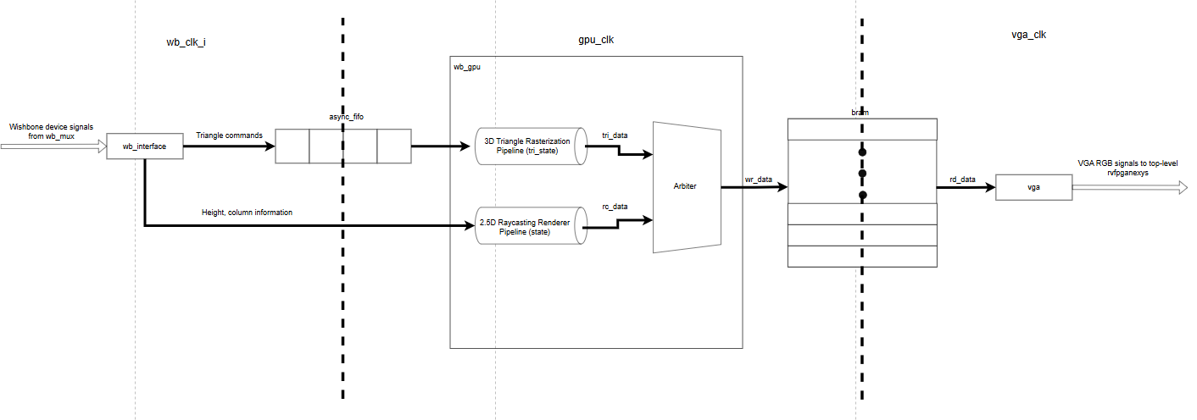
Hardware Detailed Description: VGA

Slide 8
Hardware Detailed Description: Triangle Rasterization for 3D renderer
v1(x1,y1)
v0(x0,y0)
v2(x2,y2)

Slide 9
Hardware Detailed Description: Triangle Rasterization for 3D renderer
Triangle Commands
4 commands per triangle
Command 1: v0 coordinates
Command 2: v1 coordinates
Command 3: v2 coordinates
Command 4: Color and height
A cube needs 2 triangles per face and a cube has 6 faces, therefore, 12 triangles and 12*4 = 48 commands in total.
The async FIFO was sized to the next power of 2 after 48, which is 64 entries.
Triangles are rasterized using edge functions (needs to be done per edge):
E01​(x,y)=(y−y0)(x1​−x0​)−(x−x0​)(y1​−y0​)
For a triangle, a point is inside if all three edge functions have the same sign.
To make implementation “friendly” for synthesizable hardware design, edge functions deltas (example: dx01 = x1-x0, dy01 = y1-y0) are pre-computed, multiplies are done in one pipe stage and increments to the next edge function across x and y are done in another pipe stage.

Slide 10
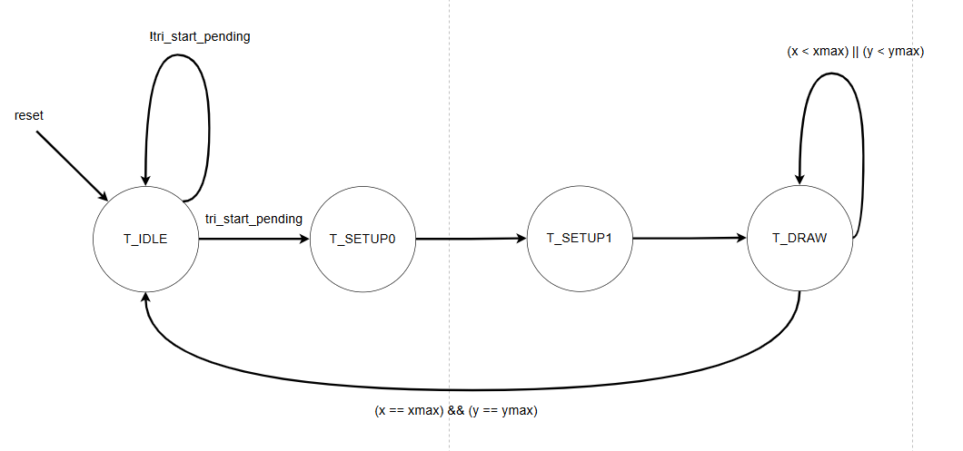
Hardware Detailed Description: Triangle Rasterization for 3D renderer
FSM states
T_IDLE
Initial state
T_SETUP0
Computes the maximum, minimum points and deltas for edge functions.
T_SETUP1
Computes the multiplications.
T_DRAW
Computes final edge functions for the current step.

Slide 11
Software Detailed Description: Raycasting
For every pixel column, a ray is cast forward at a specific angle, which travels forward until it hits a wall.
The length of this ray determines the rendered height of the wall.
Fixed point methods are used instead of floating point in order to keep frame rates stable (functional).

Slide 12
Software Detailed Description: Raycasting
When ray enters a square, distance the ray will have to travel to hit an x or y gridline is computed.
Whichever is smaller, the ray jumps to that edge.
If the square hit is a wall, the raycasting process is complete
Otherwise it continues into the next square
Being able to jump from square to square greatly reduces the number of iterations/calculations required
Once a wall is found, the distance to it is calculated.

Slide 13
Hardware Detailed Description: Raycasting
Each column is passed as a single wishbone data packet containing:
The calculated column height
The x-coordinate of the column within the wall the contains it
The pixel coordinate of the column on the screen
Simple FSM iterates over each pixel in the column
Calculate the texture array and frame buffer address
Access the texture array to determine the wall color
Write the result to the frame buffer
Column height is also written to the z-buffer for use in cube rendering.

Slide 14
Hardware Detailed Description: VGA and Frame Buffer
The VGA module is quite similar to the one implemented in in project 2
Every cycle the current dgt pixel is used to access an element in the frame buffer
The color retrieved from the frame buffer is sent to the monitor
The outputs from the dtg module are delayed by two clock cycles to align with the timing of the frame buffer reads
The frame buffer module implements two frame buffers to prevent screen tearing
The GPU writes to one frame buffer and the VGA module reads from the other
When the GPU finishes its frame it sets a flag to indicate that it is done
The VGA initiates a swap when it finishes its current frame output

Slide 15
Software Detailed Description: Mesh Rendering
Cubes are modeled as 8-vertex, 6-face meshes
Vertices are rotated and translated in fixed-point arithmetic
Vertices are then projected to screen space with perspective projection
Geometry off screen or too close to the player are removed
Visible faces are depth-sorted with a Painter’s Algorithm
Each face is shaded with a simple directional lighting model and drawn as 2 triangles

Slide 16
Software Detailed Description: Mesh Rendering
Perspective projection
x_screen = x_center + ( x * f / y )
y_screen = y_center - ( z * f / y )
Rotation (2D example)
x` = x cosθ - y sinθ
y` = x sinθ + y cosθ
Face normal
n = ( v_1 - v_0 ) x ( v_2 - v_0 )
Lighting
light = n • l

Slide 17
Conclusion
Committed goals
Basic 2.5D environment
Single 3D object rendering
Stretch goals
Integration of 3D objects into 2.5D environment
Texture mapping of the 2.5D scene walls
Basic lighting on the 3D object
All committed and stretch goals were met
Challenges
Timing convergence of hardware was a challenge and it required reinventing existing graphics pipeline methods into balanced pipeline stages (typically graphics pipeline are implemented with high parallelism using threads or SIMT).
Identifying if a visual bug is originating in hardware or software was not always obvious at times.

Slide 18
Project Demo

Slide 19
Future Work
There are a number of improvements we can make to this project.
Floor, ceiling, and cube textures
Further improvements to FPS by optimizing program code.
More 3D sprite shapes (Pyramids, ect…)
Improvements to the top level gameplay (It is quite basic currently)

